Slide 1
Roots: Open Methods

Slide 2
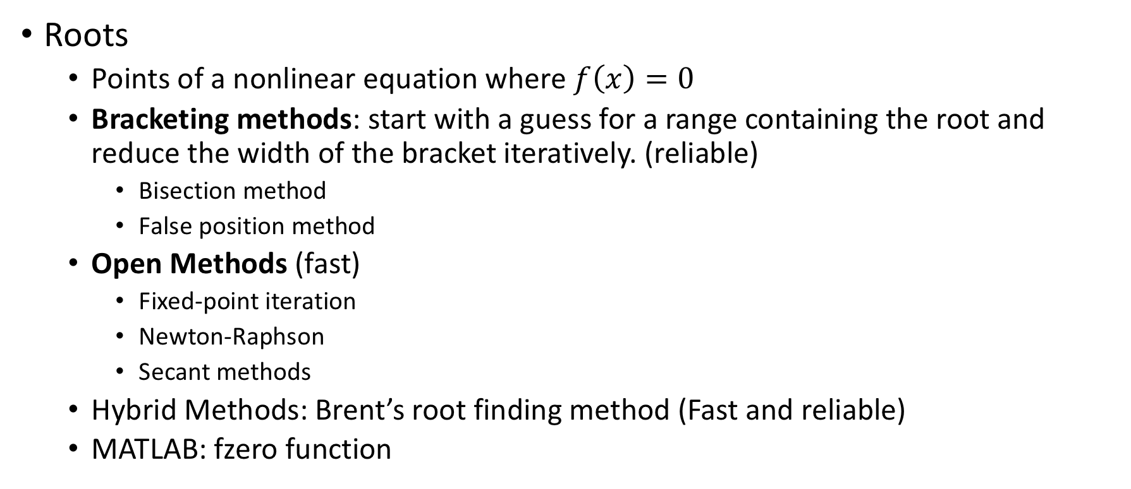
Overview
Roots
  Points of a nonlinear equation where $f\left(x\right)=0$
  Bracketing methods: start with a guess for a range containing the root and reduce the width of the bracket iteratively. (reliable)
    Bisection method
    False position method
  Open Methods (fast)
    Fixed-point iteration
    Newton-Raphson
    Secant methods
  Hybrid Methods: Brent’s root finding method (Fast and reliable)
  MATLAB: fzero function

Slide 3
Chapter Objectives
Recognizing the difference between bracketing and open methods for root location.
Understanding the fixed-point iteration method and how you can evaluate its convergence characteristics.
Knowing how to solve a roots problem with the Newton-Raphson method and appreciating the concept of quadratic convergence.
Knowing how to implement both the secant and the modified secant methods.
Knowing how to use MATLAB’s fzero function to estimate roots.
Learning how to manipulate and determine the roots of polynomials with MATLAB.

Slide 4
Overview
Bracketing Methods: always result in closer estimates of the true value of the root. (they are convergent)
Open Methods: require a single starting point or two starting values that do not necessarily bracket the root
  They sometimes diverge (move away from the root) as the computations progress.
  When they converge, they are faster.

Slide 5
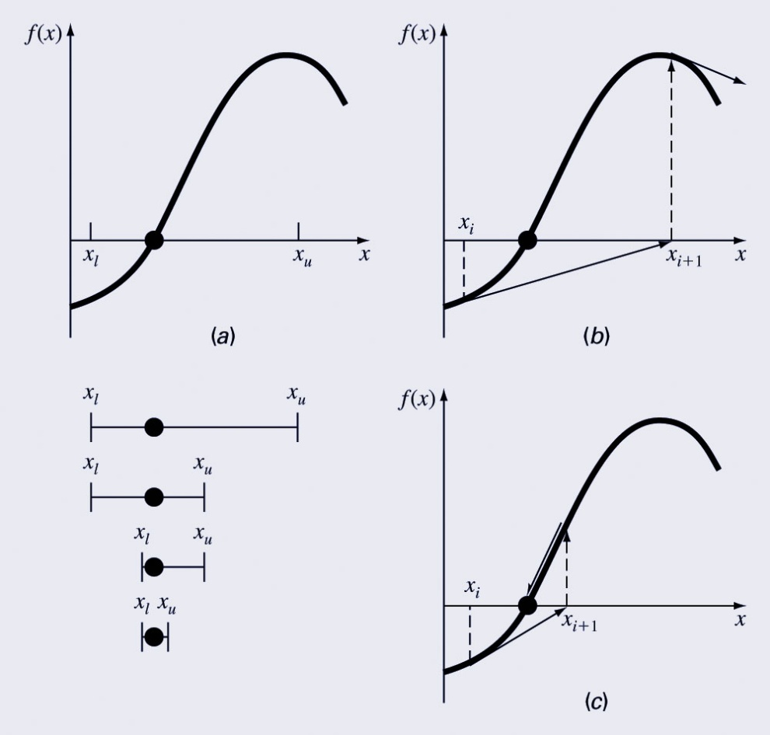
Graphical Comparison of Methods
Bracketing method
Diverging open method
Converging open method - note speed!

Slide 6
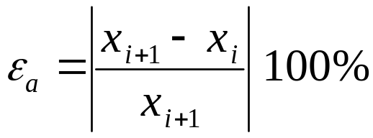
Fixed Point Iteration
Also called: one-point iteration or successive substitution
Rearrange the function f(x)=0 so that x is on the left-hand side of the equation: x=g(x)
Use the new function g to predict a new value of x - that is, x_{i+1}=g(x_{i})
The approximate error is given by:

Slide 7
Example
Solve f(x)=e^{-x}-x
Re-write as x=g(x) by isolating x (example: x=e^{-x})
Start with an initial guess (here, 0)
Continue until some tolerance is reached
True value is: 0.56714329.
i | x_{i} | |ε_{a}| % | |ε_{t}| % | |ε_{t}|_{i}/|ε_{t}|_{i-1}
0 | 0.0000 |  | 100.000
1 | 1.0000 | 100.000 | 76.322 | 0.763
2 | 0.3679 | 171.828 | 35.135 | 0.460
3 | 0.6922 | 46.854 | 22.050 | 0.628
4 | 0.5005 | 38.309 | 11.755 | 0.533

Slide 8
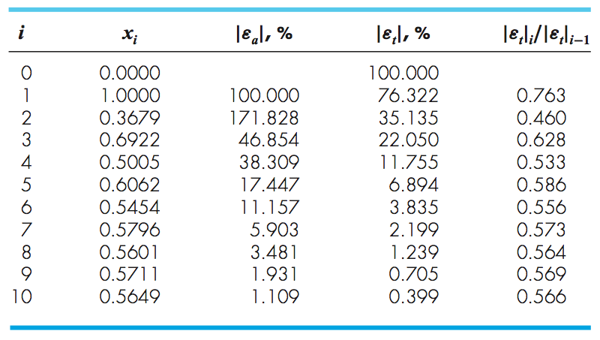
Example
Solve f(x)=e^{-x}-x

Slide 9
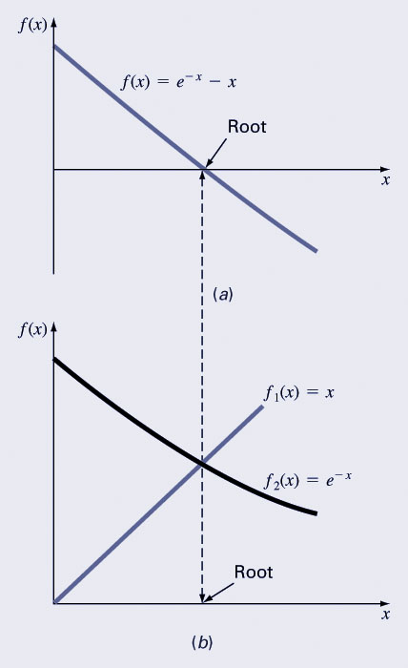
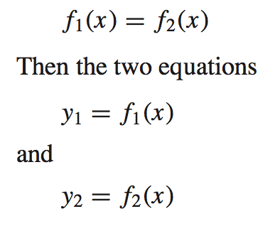
Alternative Approach
Seperate the equation into two component parts
Can be plotted seperately. The x values corresponding to the intersections of these functions represent the roots f(x) = 0.

Slide 10
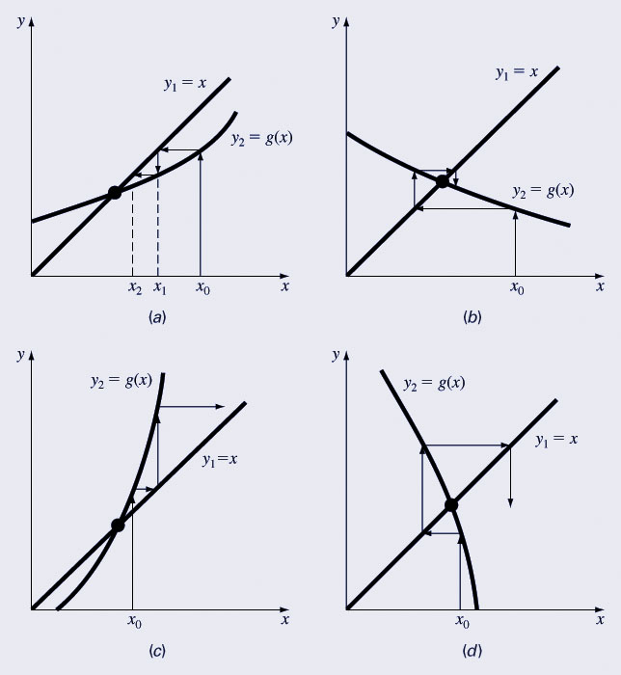
Convergence
Convergence of the simple fixed-point iteration method requires that the derivative of g(x) near the root has a magnitude less than 1.
  Convergent, 0 ≤ g’ <1
  Convergent, -1 < g’ ≤0
  Divergent, g’ > 1
  Divergent, g’ < -1

